Slide 1
Source Code Management tools, Git, GitHub and Software Setup, Command of Git tools part-1
- Pranali chougule

Slide 2
What is Source code Management Tools?
Source Code Management (SCM) tools are systems used to track changes in software code.
They are essential in managing and maintaining a codebase, particularly in collaborative development environments where multiple developers are working on the same project.
SCM tools facilitate version control, collaboration, and maintain a history of changes made to the code over time.

Slide 3
Benefits of SCM Tools
Version Control
Collaboration
Branching and Merging
Change Tracking
Backup and Recovery
Continuous Integration/Continuous Deployment (CI/CD) Support

Slide 4




Populer Source code management tools
GitHub : A web-based platform built on Git, providing version control and collaboration. It integrates with various tools for project management, CI/CD, and more.
Bitbucket : A version control hosting service from Atlassian that supports Git and Mercurial. It integrates well with Jira, Trello, and Slack.
Azure DevOps : A Microsoft platform combining version control, project management, and CI/CD. Supports Git and TFVC.
Git: A decentralized, open-source version control system. It allows distributed collaboration and is highly customizable.

Slide 5
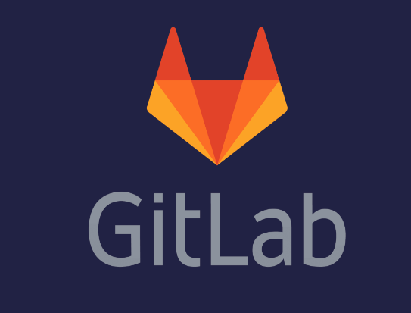



Populer Source code management tools
GitLab : A web-based Git repository manager that offers CI/CD, code review, and project management. GitLab CI is integrated for continuous delivery.
Apache Subversion (SVN) : An open-source, centralized version control system known for handling large codebases and collaboration.
Mercurial : A distributed version control system like Git, known for handling large projects and efficient branching.
IBM Rational ClearCase: A commercial SCM tool supporting large and complex projects, known for handling large binary files and offering robust security.

Slide 6
Git
Git is a free, open-source, distributed version control system (DVCS) designed to handle everything from small to very large projects with speed and efficiency.
Created by Linus Torvalds in 2005 to manage the development of the Linux kernel, Git is now widely used in both open-source and commercial projects for managing source code and enabling collaboration among developers.
Git is used to tracking changes in the source code, enabling multiple developers to work together on non-linear development.
Git Hosting platforms are Github, Bitbucket and GitLab.

Slide 7
Key Features of GiT
Distributed Version Control
Branching and Merging
Commit Tracking
Staging Area
Distributed Workflows
Fast Performance
Integrity and Security

Slide 8
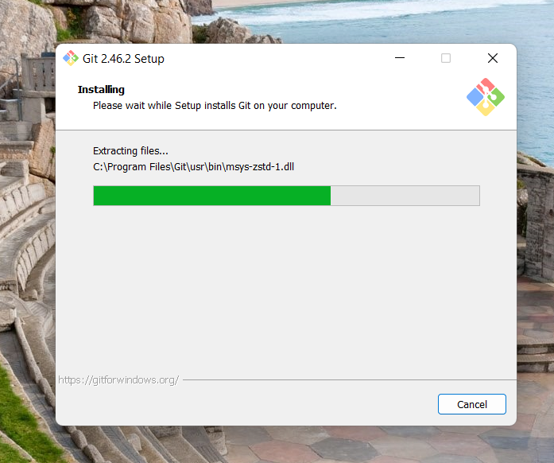
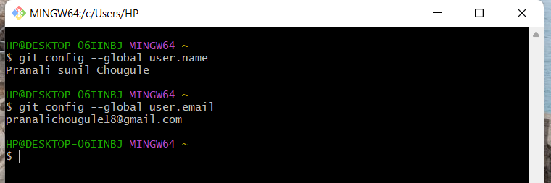
Setup Git for Windows
Download the latest version of Git from the official website: Git for Windows
Run the installer and follow the instructions.
During the installation, you can choose options like:
Adjusting your PATH environment.
Choosing a text editor (e.g., Vim, Notepad++, VSCode).
Setting up Git Bash as your command line interface.
After installation, open Git Bash (or Command Prompt/PowerShell) to use Git commands.

Slide 9
GitHub
GitHub is a web-based platform built on top of the Git version control system, designed for developers to manage, collaborate, and share their code.
It’s one of the most popular platforms for open-source and private software projects, offering tools for version control, issue tracking, project management, and continuous integration and deployment (CI/CD).
GitHub has become a central hub for millions of developers and teams worldwide, enabling seamless collaboration and the sharing of code.

Slide 10
Key Features of GitHub
Git Repository Hosting
Collaboration via Pull Requests
Branching and Merging
Issue Tracking
GitHub Actions (CI/CD)
Project Management Tools
GitHub Pages
GitHub Marketplace

Slide 11
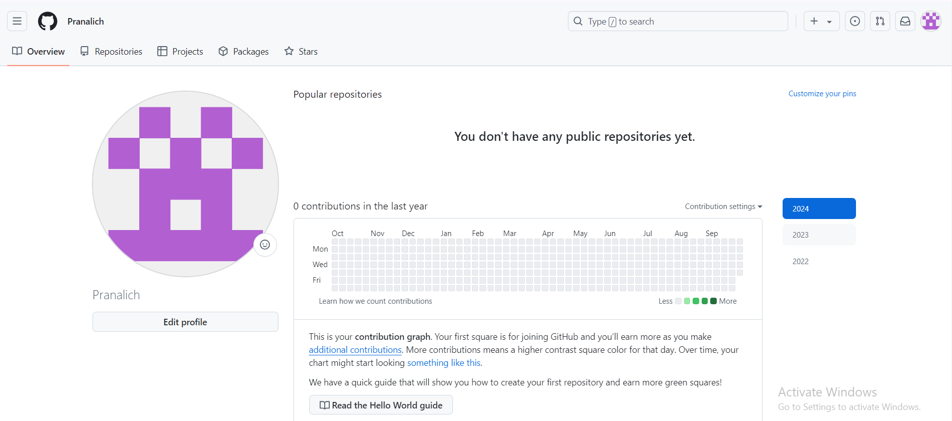
Setup Github for Windows
Create a GitHub Account on github website

Slide 12
Basic git commands
git init: Initialize a new Git repository.
git clone [url]: Clone an existing repository from a remote source.
git status: Check the status of files in the working directory and staging area.
git add [file]: Add changes in a file to the staging area.
git commit -m "message": Commit the staged changes with a descriptive message.
git push: Push the committed changes to a remote repository.
git pull: Fetch the latest changes from a remote repository and merge them.
git branch: List, create, or delete branches.
git checkout [branch]: Switch to a different branch.
git log: View the commit history.

